Slide 1
L4-SNA
Musica Supriya

Slide 2
Network Structures and its measures
Nodes & Edges
Directed & Undirected
Degree of a node
In-degree
Out-degree

Slide 3
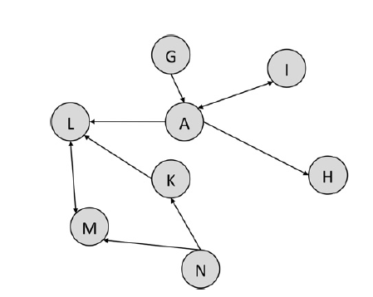

Slide 4
Which node is more important in the previously shown graphs?

Slide 5
Centrality
How do you measure a node is central?
List the properties based on which you measure the importance of a particular node

Slide 6
Types of Centrality
Degree Centrality
Closeness Centrality
Betweenness Centrality
Eigen Vector Centrality

Slide 7
Degree Centrality
Periphery
Core

Slide 8
Closeness Centrality
How close a node is to all other nodes in the network
Average of the shortest path length from the node to every other node in the network

Slide 9
Calculate the shortest path length wrt Node D

Slide 10
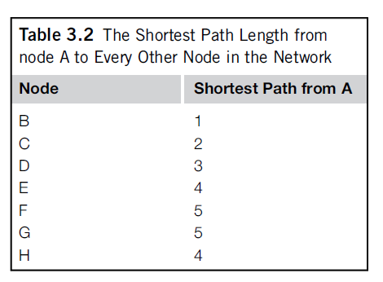
24/7=3.43

Slide 11
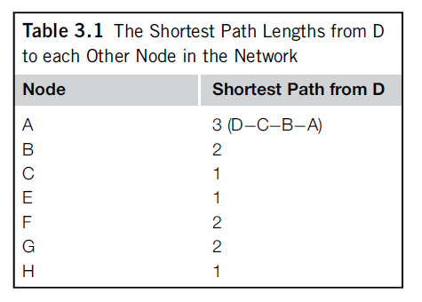
12/7=1.71

Slide 12
Betweenness Centrality
How important a node is to the shortest paths through the network

Slide 13
AC, AD, AE, AF, AG, AH, CD, CE, CF, CG, CH, DE, DF, DG, DH, EF, EG, EH, FG, FH, and GH.
Without counting, we know that 100% of the shortest paths from A to every other node in the network go through B, since A can’t reach the rest of the network without B. Thus, the fractions for AC, AD, AE, and AF AC, AD, AE, AF, AG, and AH are all 1.
6×1 (A to all others) + 0.5 (CD) + 14×0 (all remaining pairs) = 6 + 0.5 + 0 = 6.5
the betweenness centrality of A is zero, since no shortest paths between D, C, D, E, and F C, D, E, F, G, and H go through A.

Slide 14
Eigen Vector Centrality
Links of important nodes are worth more than links from unimportant nodes.

